Slide 1
The “Hands Free” Control Helmet
Brandon Hernandez
Robert Maksimowicz
Harrison Burkoff

Slide 2
Cars have blind spots and it is really easy to forget to check it, or miss something in your blindspot.
Especially at night, unless something has a light source, it is really easy to get caught up in the dark.
This is why most cars have a sensor to turn on the headlights automatically when the light level is too low outside, but bicycles often don’t…
This makes riding at any point of night or evening dangerous

Slide 3
As far as statistics from the last slide goes, cyclist visibility is important to capture a drivers attention and decrease risks.
This is further backed up by an experiment from Madsen, Anderson and Lahrmann which resulted in a much lower incidence rate by 19% “for cyclists with permanent running lights mounted” [8]
This makes complete sense when you combine all the statistics… Drivers are the main cause of bicyclist accidents, but in order prevent more accidents bicyclists should be more visible on the road, especially at night!
One way to help reduce the risk of crashes is through the consumer market.
With more options out there for purchase people can choose to reduce their risk further

Slide 4
Our Solution
Lighting on bicycles leads to a 19% reduction in incidents overall.
Making a helmet that doesn’t just increase safety, but also visibility compounds the benefit of having a helmet that features built-in lighting.
Our solution would be unique to other solutions since all light control would utilize a built in Inertial Measurement Unit (IMU) and a solar panel.
LEDs to alert motorists of breaking and turning would be controlled hands free.
A higher position of lighting will allow superior visibility.
This would provide an easy-to-use featureset will allow users to communicate with motorists as well as increased visibility for the rider.

Slide 5
What makes it different?
A natural “head tilt” is more intuitive than any other form of control, since it requires the least distraction for the cyclist.
The IMU’s gyroscope and accelerometer gather a 3D mapped data set to trigger functions at preset boundary conditions.
This allows for complete head motion control via utilizing the IMU.
We offer a solar charging system that is used to increase convenience by always having a charged battery and providing alternate greener charging.

Slide 6
Carbon Emissions?
Cars and buses can generate a large amount of CO2
According to the European Cycling Federation
Car production of a car can account for 42 grams of CO2 per kilometer and 271 grams of CO2 per kilometer on average when driving. Buses produce about 100 grams of CO2 compared to cars [4].
Cycling can bring emissions down to a minimum with no fuel, no exhaust, no combustion. Bicycle production only emits 5 grams of CO2[4].

Slide 7
How does our specifications match up with the standards?
CPSC Standard: Established in March 10th, 1999
A helmet can withstand a drop of 2.0 meters on a flat anvil and 1.2 meters on a curbstone anvil with a 300 gram failure threshold [7].
A call for limitations on lead and phthalates.
Our component success rate on impact.
However, the helmet itself is guaranteed to protect the user up to said standards. A more robust packaging of our system may be an improvement to implement within an updated revision.
Notes:
Harrison [End]

Slide 8
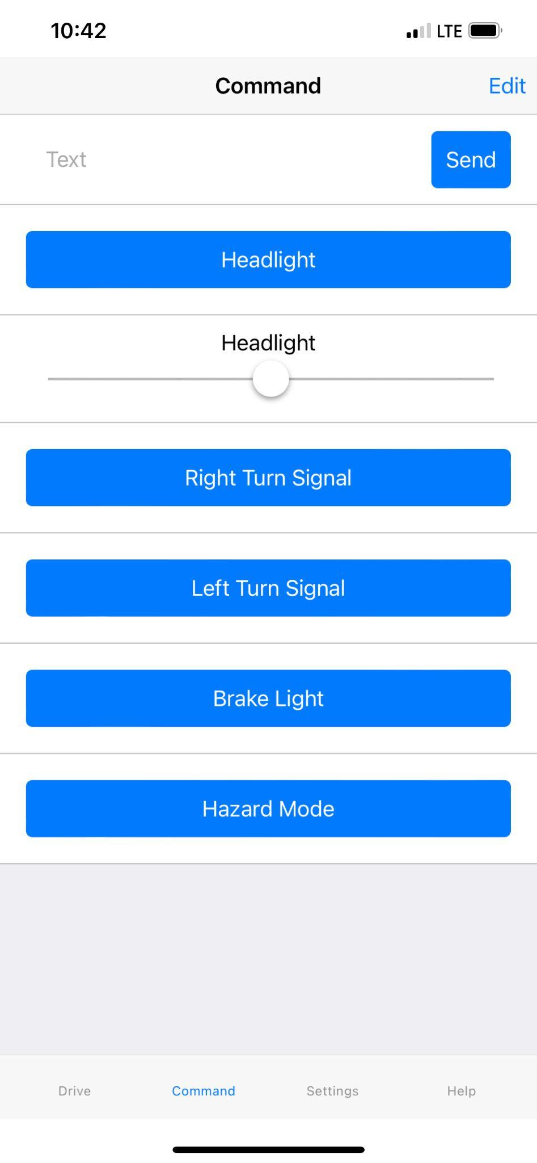
App Functionality
Figure 1.1
shown is the layout and general functionality of working app. Complete with Headlight, Turn Signals, Brake Light and Hazard Mode controls.
Bluetooth Connectivity
Battery Level
Solar Charging Power
Headlight Control
Tail Light Control
Manual Brake Light Control
Left and Right Turn Signal Control
All Lights are Brightness Controllable (except brake)
Notes:
Brandon [Start]

Slide 9
Our Components
LEDs
144 LEDs per meter lasting 50,000+ hours of life
Input Voltage(V): 5VDC
Working Power(W): 16W Max
Lumen/LED(Lumen): 24~26 Lumen (3700 Lumen)
Battery - $35.98
Voltage(V): 3.7VDC
Capacity: 4000mAh
Lithium Polymer
Weight(g): 58g
Solar Panel - $9.99
Power(W): 1W, 6VDC Max
Weight(g): 28g
IMU 9 Axis (Accelerometer, Gyroscope & Magnetometer) - $35.19
Connector Type: 12C
Frequency(Hz): 32kHz
Built in 3.3V Regulator and Logic Level Shifter
16 bit AD converter
Helmet (Base) - $26.99
Weight(g): 501g
Outer Material: ‎Acrylonitrile Butadiene Styrene
Arduino Pro Micro Development Board - $24.49
Voltage(V): 5V
Frequency(Hz): 16MHz
Serial Interface
12x I/O Ports
Voltage Regulator Board - $9.99
Input Voltage Range(V): 2V-24V
Output Voltage Range(V): 5V-28V
Output Current(A): 2A Max
Connector Type: Micro USB
Battery Charger Module - $5.99
Connector Type: USB-C
Lift Voltage(V): 4V
Over-Current Protection(A): 3A
Current Output(A): 1A Max
LED 3-State Indicator
HM-10 Bluetooth Module - $10.99
Low Energy: With HM-10 bluetooth 4.0 module
Total ≅ $184.59 + Tax & Shipping

Slide 10
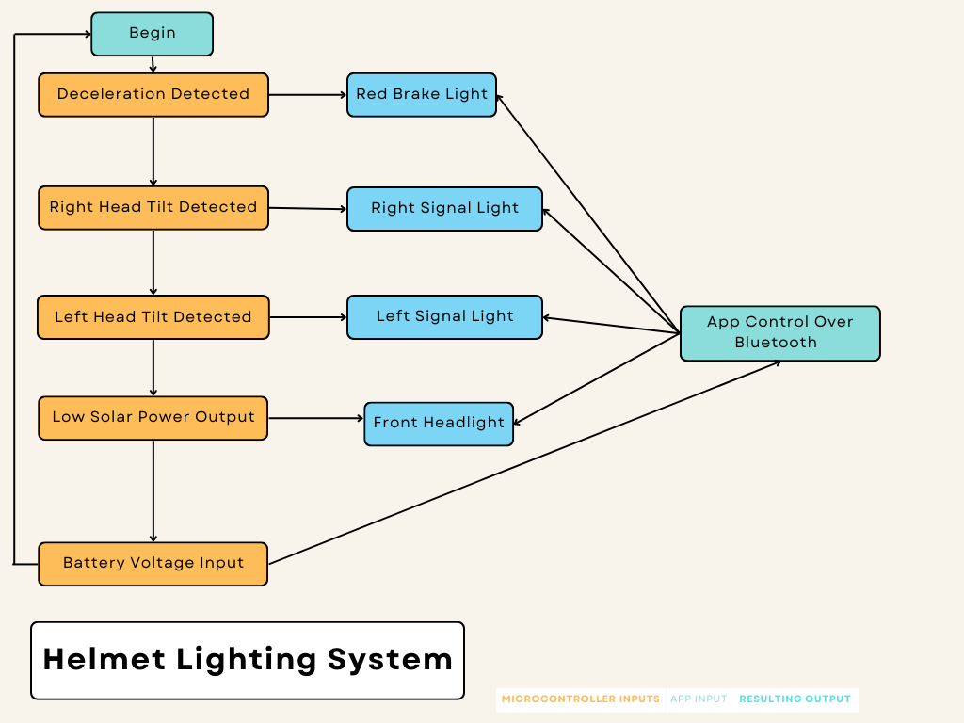
Flow Chart
Figure 1.2)
It’s shown the inputs and outputs of the microcontroller and thus the direction in which data flows in or out of the microcontroller. It also lists the components and their final resulting output.

Slide 11
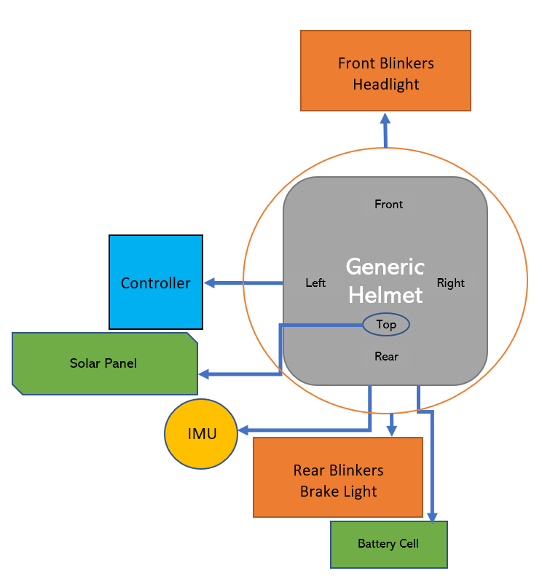
Block Diagram
Figure 1.3)
Here is a basic layout of the components used in our design along with their descriptions.
Topographic View

Slide 12
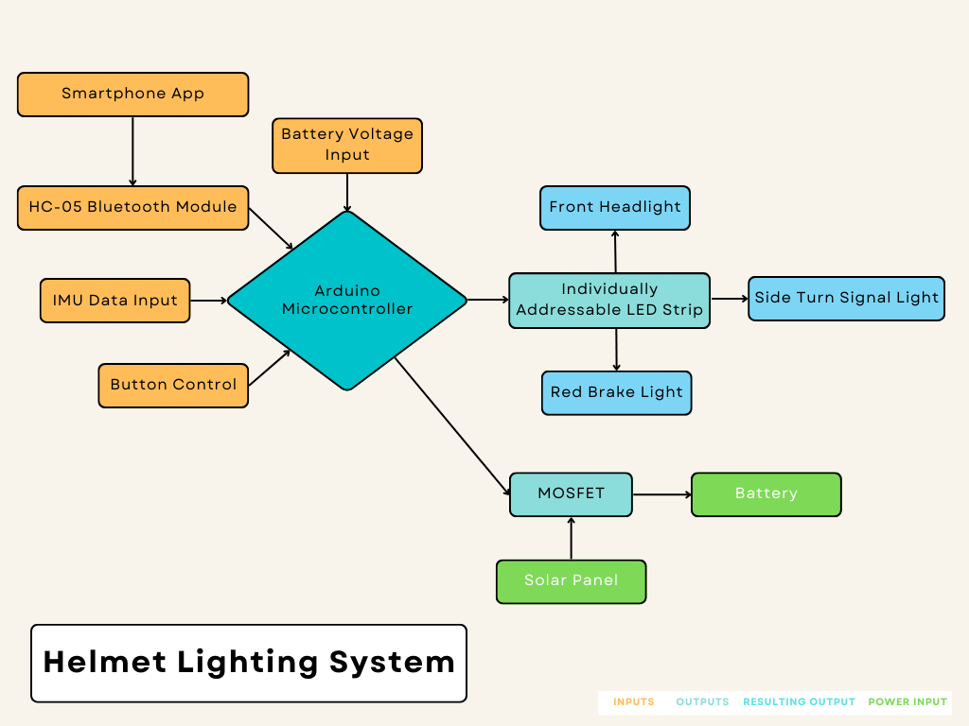
Figure 1.4)
Here is a basic layout of the components used in our design along with their descriptions.
Input-Output view
Notes:
Brandon [End]

Slide 13
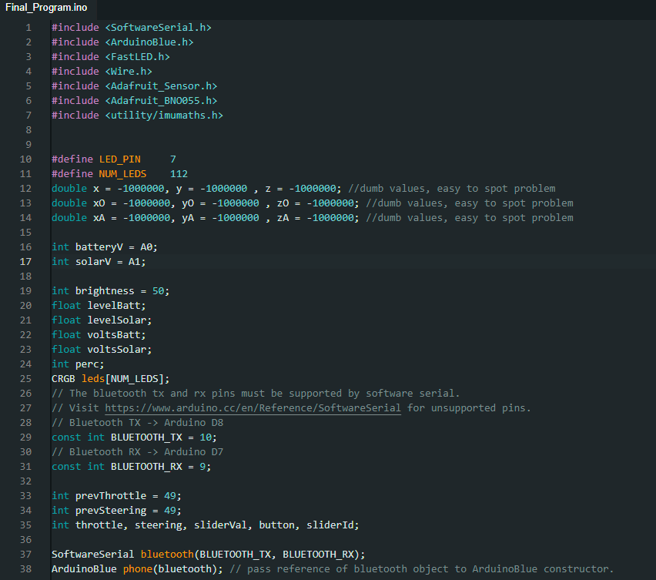
Figure 4.1)
This is the initialization of most of the variables used in the code, they are very self explanatory for the purposes of adding each component into the program. The libraries involved were for ArduinoBlue, Adafruit, and imu calibration.
Notes:
Robert [Start]

Slide 14
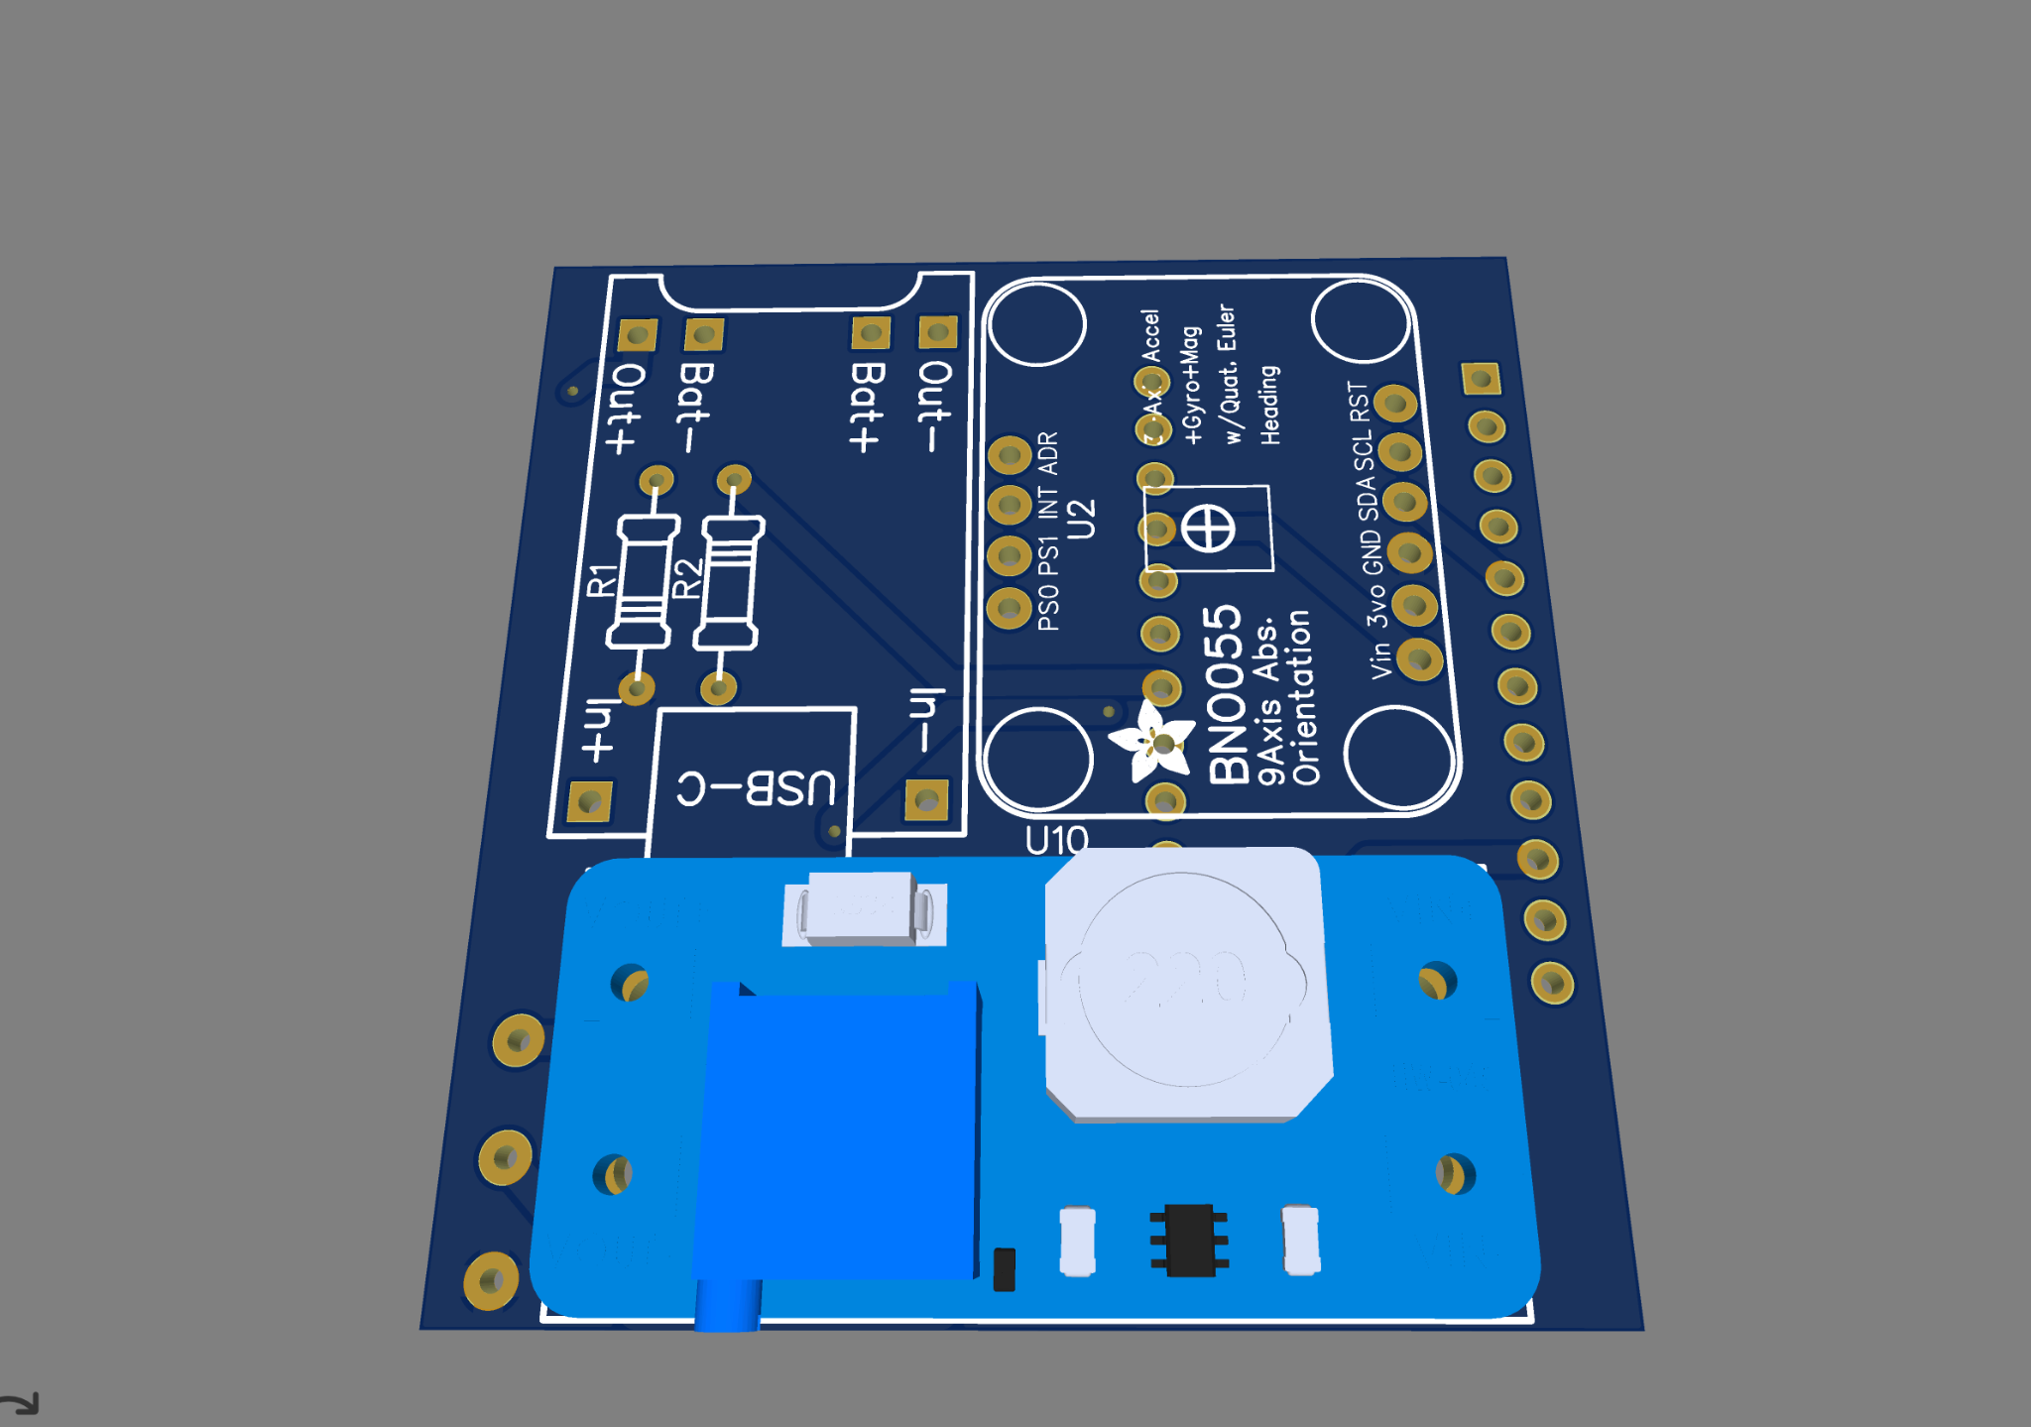
Figure 4.2)
This is the design of the PCB that we created to place inside the final product, it is a layered pcb showing the microcontroller and bluetooth module here. It is a 2-layered design.

Slide 15
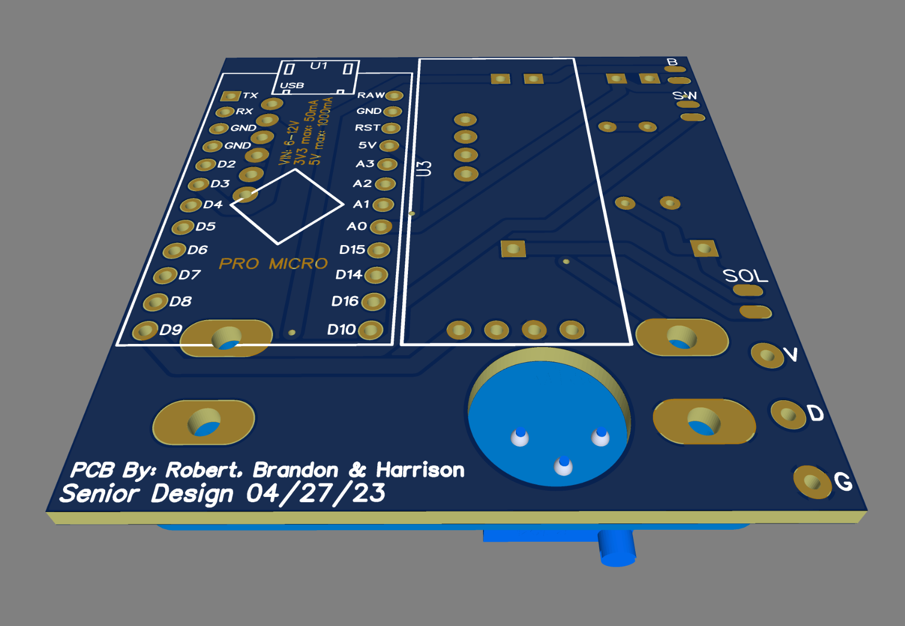
(continued)
Figure 4.2)
This is the second layer of the PCB showing voltage regulator and 9-axis IMU attached to the underside of the board. The battery is wired into this side of the PCB

Slide 16
Characterization of the System
Power Consumption: 5.6 Watts (Max) - 2 Watts (Average)
Battery Life (calculated from average consumption): ~7 hours
Battery Capacity: 4000 mAh or 14.8Wh
Solar Output in Daylight: .86 Watt - Time to charge: 17.29 hrs from solar
USB-C Charging Speed: ~5 Watts which is less than 3 hours to fully charge

Slide 17
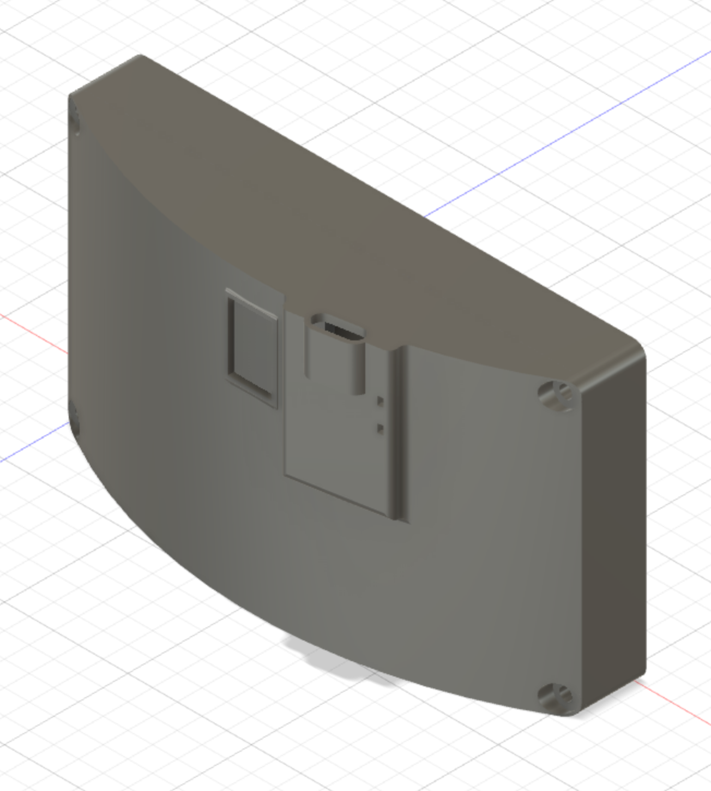
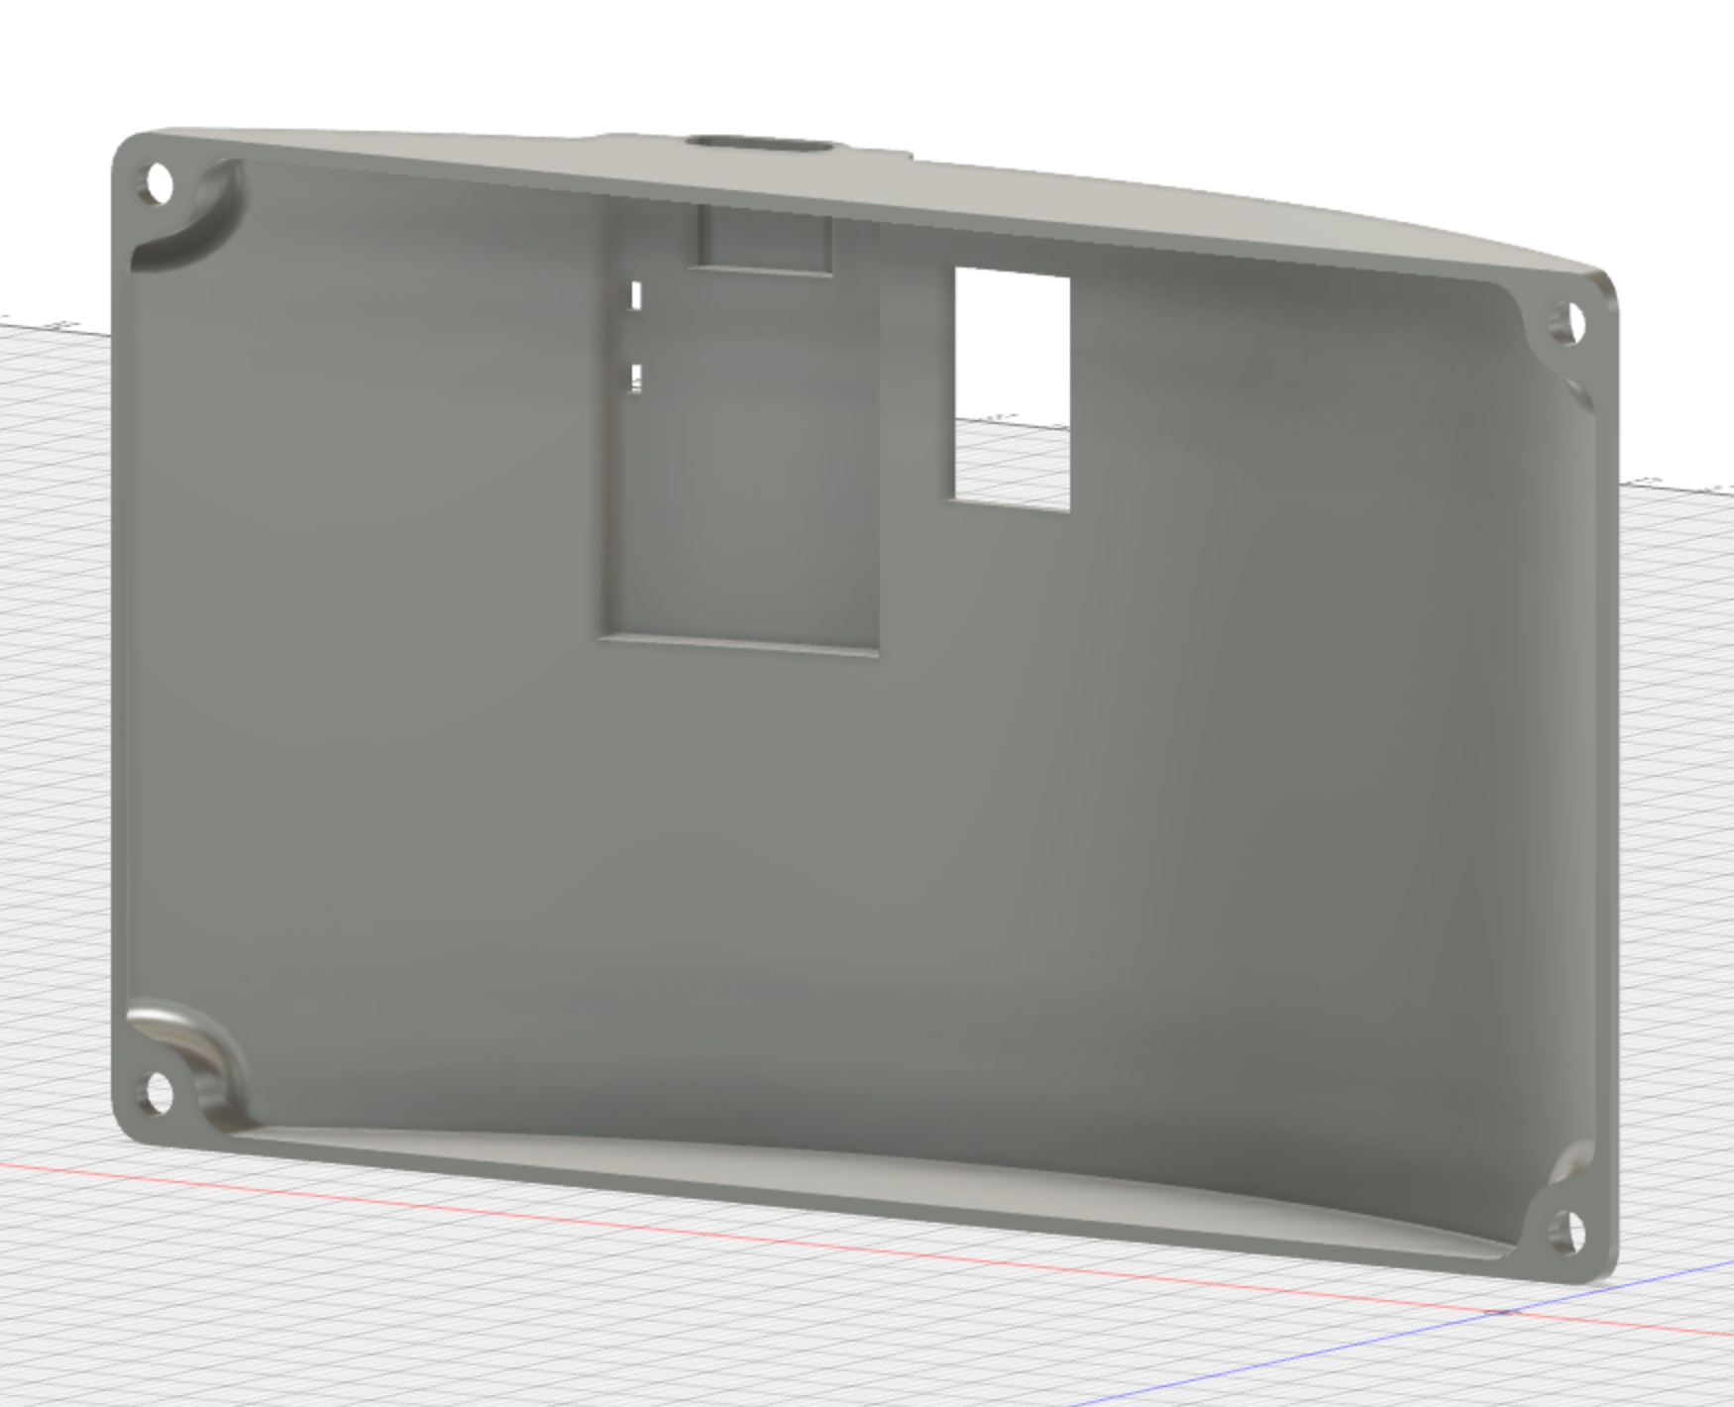
Figure 4.4)
The lid is slanted to fit with the profile of the helmet, it includes a lid with a USB-C Charging port.

Slide 18
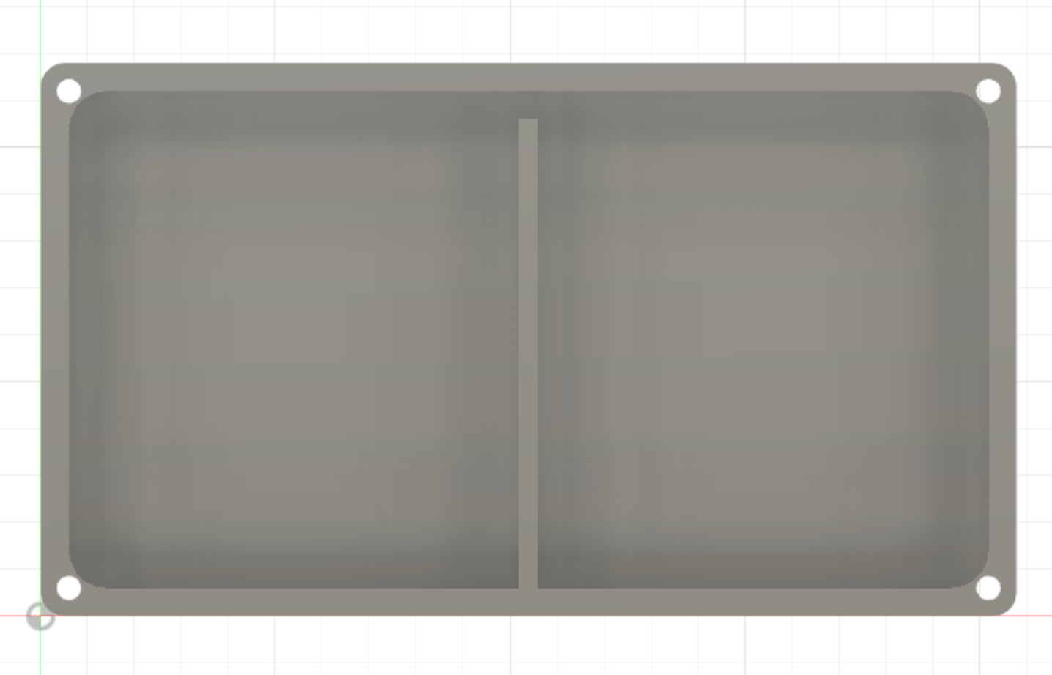
(continued)
Figure 4.5)
This is the bottom casing component for the PCB in the diagram, width to support the small PCB designed and the components wired to the PCB.

Slide 19
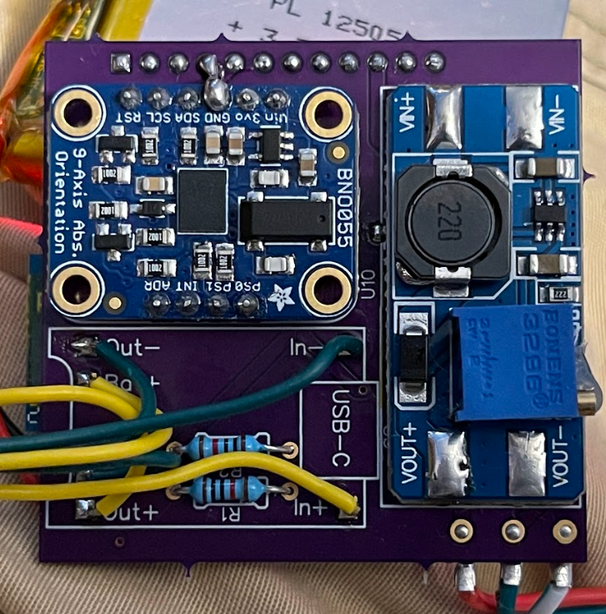
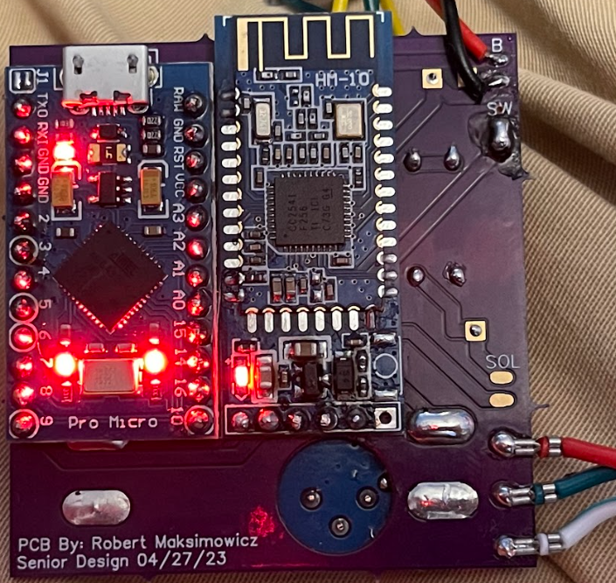
Fig 4.6) Pictures of the Project

Slide 20
References
[1] ArduinoBlue. Google Sites: Sign-in. (n.d.). Retrieved May 4, 2023, from https://sites.google.com/stonybrook.edu/arduinoble/#h.p_TqD1cnyO-TO2 [Accessed: 4-May-2023].
[2] Department of Transportation (DOT). “Bicycle Crash Data Report - New York City,” Bicycle Crash Data Report 2020. [Online]. Available: https://www1.nyc.gov/html/dot/downloads/pdf/bicycle-crash-data-report-2020.pdf. [Accessed: 10-Dec-2022].
[3]Department of Transportation, “Bicycle Safety,” NHTSA, 2018. [Online]. Available: https://www.nhtsa.gov/road-safety/bicycle-safety . [Accessed: 15-Dec-2022].
[4]How much CO2 does cycling really save? ECF. (2021, April 22). Retrieved May 5, 2023, from https://ecf.com/news-and-events/news/how-much-co2-does-cycling-really-save [Accessed: 5-May-2023].
[5] A. Benepe, T. R. Frieden, R. W. Kelly, and I. Weinshall, “Bicyclist fatalities and serious injuries in New York City,” Bicyclist Fatalities and Serious Injuries New York City. Oct-2009[Online]. Available: http://www.nyc.gov/html/dot///downloads/pdf/bicyclefatalities.pdf. [Accessed: 10-Dec-2022].
[6] J. Mandel-Ricci, C. Stayton, L. Nicaj, S. Assefa, D. Woloch, K. Jeffrey, P. McCarthy, and N. Budnick, “A multiagency effort to reduce bicyclist fatalities and serious injuries in New York City,” Public health reports (Washington, D.C. : 1974), Sep-2008. [Online]. Available: https://www.ncbi.nlm.nih.gov/pmc/articles/PMC2496939/. [Accessed: 10-Dec-2022].
[7] R. Thompson, F. Rivara. D. Thompson; “A case-control study of the effectiveness of bicycle safety helmets,” The New England journal of medicine, 25-May-1989. [Online]. Available: https://pubmed.ncbi.nlm.nih.gov/2716781/. [Accessed: 10-Dec-2022].
[8] D. Roe and D. Jackson, “Drivers are making more mistakes... and killing more New York cyclists,” Bicycling, 11-Mar-2021. [Online]. Available: https://www.bicycling.com/news/a31122171/nyc-cycling-crash-data/. [Accessed: 10-Dec-2022].
[9] J. C. Reiter, “Bicycle accident injuries in New York City update 2021 by New York City bicycle accident lawyer Jonathan C. Reiter,” GlobeNewswire News Room, 23-Feb-2021. [Online]. Available: https://www.globenewswire.com/en/news-release/2021/02/23/2180836/0/en/Bicycle-Accident-Injuries-in-New-York-City-Update-2021-by-New-York-City-Bicycle-Accident-Lawyer-Jonathan-C-Reiter.html. [Accessed: 10-Dec-2022].
[10] J. C. O. Madsen, T. Andersen, and H. S. Lahrmann, “Safety effects of permanent running lights for bicycles: A controlled experiment,” Accident Analysis & Prevention, vol. 50, pp. 820–829, 2013.
[11] J. Walljasper, “10 reasons bicycling will continue to soar in popularity,” Strong Towns, 19-Feb-2018. [Online]. Available: https://www.strongtowns.org/journal/2018/2/9/12-reasons-bicycling-will-continue-to-soar-in-popularity. [Accessed: 10-Dec-2022].
[12] Kevin Glenton. “Best bike helmets with lights built-in [top 6],” Discerning Cyclist, 10-Nov-2022. [Online]. Available: https://discerningcyclist.com/best-bike-helmets-with-lights-built-in/#lumos. [Accessed: 11-Dec-2022].
[13] VectorNav. “What is an inertial measurement unit?,” VectorNav. 2010 [Online]. Available: https://www.vectornav.com/resources/inertial-navigation-articles/what-is-an-inertial-measurement-unit-imu?gclid=CjwKCAiAvK2bBhB8EiwAZUbP1BdmJvL5DiYV3EuZJFfK2G6akUy2WY4xkWOgVw7X_Sd5P7GGKFf6BRoCBs0QAvD_BwE. [Accessed: 10-Dec-2022].
[14] A. Küderle, “Imucal,” PyPI, 17-Oct-2022. [Online]. Available: https://pypi.org/project/imucal/. [Accessed: 10-Dec-2022].

Slide 21
Results
Upon completion we have:
Functional Brake Light System
Upon a braking force, the rear LEDS should light for the duration of that force.
Functional Turn Signals
Upon a specified degree of tilt, both the front and rear signals should light for 15 seconds.
Functional Headlight
Upon a button press, the front headlight and rear tail light LEDs should light constantly.
Hazard Mode
Upon a specified g-force from impact, all LEDs will blink red continuously until deactivated via system reset.
Solar Charging
Will have the ability to sustain or even add to the battery level of the helmet during day-time hours.
App Compatibility
Charge timing/lifespan
Efficiency
Remote Functionality
Complete Head Motion Control

Slide 22
Thank You!

